Slide 1


Unit 1
What is data interpretation?
Notes:
Welcome to Unit 1 of Module 4.
In this unit, we will look at the meaning of data interpretation in the context of the HHFA.

Slide 2
By the end of this unit, you will:
explain the meaning of data interpretation in the context of the HHFA
Notes:
By the end of this unit, you will explain the meaning of data interpretation in the context of the HHFA.

Slide 3

Going from data description to interpretation
We need to go beyond the description of data:
Module 3
HHFA data review and description
data are “dumb”- do not communicate meaning for themselves
data must be interpreted to understand their meaning
Module 3: stages in the initial review/description of HHFA data
Notes:
In Module 3 we discussed the stages in the initial review and description of HHFA data.
These stages are essential but they are not enough – we need to go beyond a mere description of data.
Data are “dumb”- they do not communicate meaning for themselves. Therefore, we need to interpret the data to understand their meaning.

Slide 4

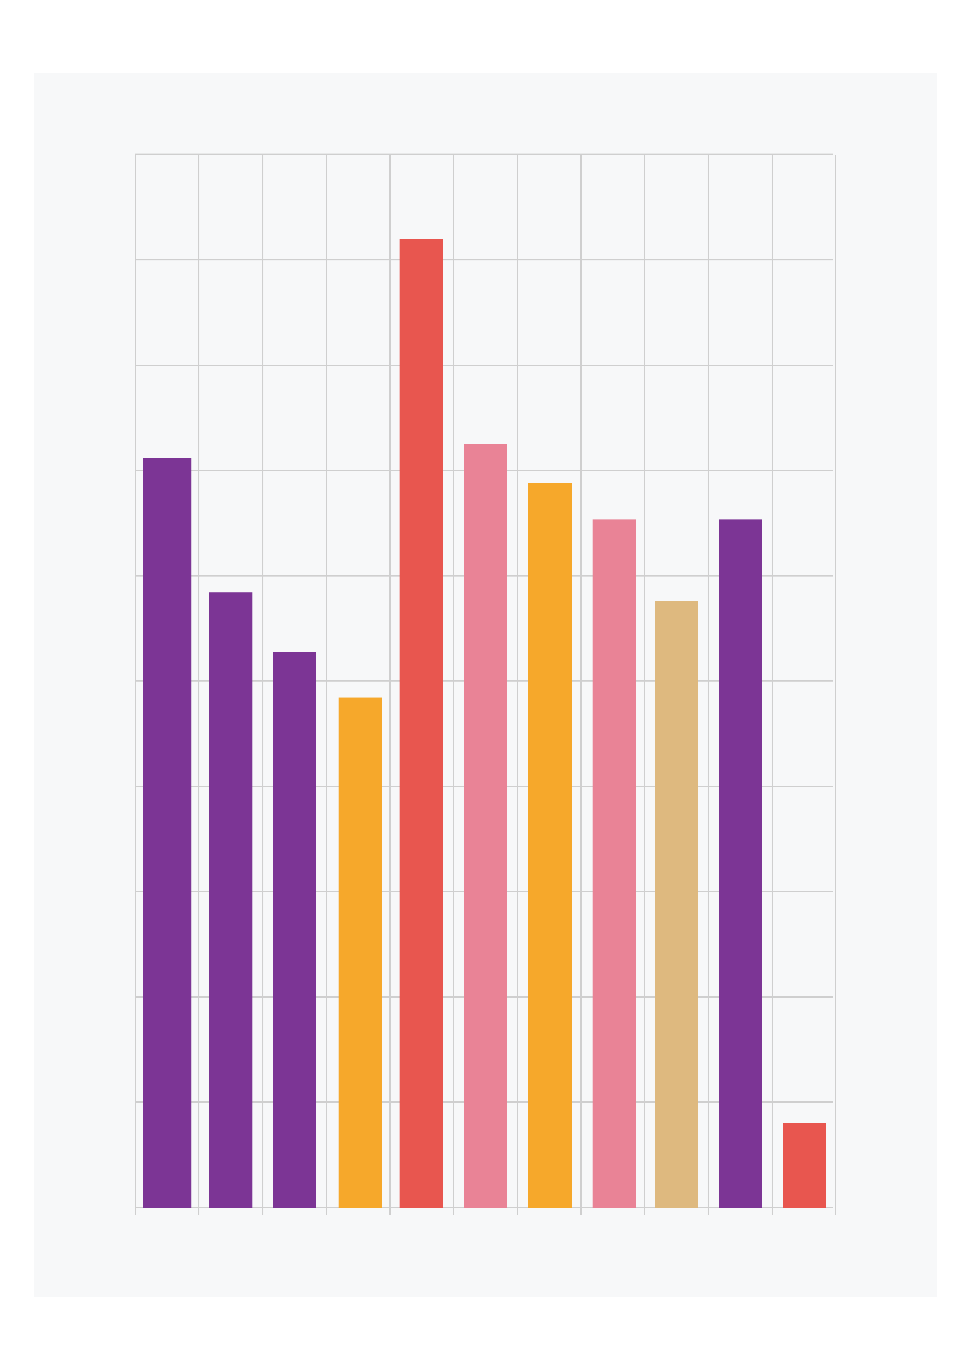
What is data interpretation?
Data interpretation aims to understand:
what the data mean in the country context
the reasons behind the findings
Notes:
Data interpretation is a process that aims to understand what the HHFA data mean within the country context and to explore the reasons behind the findings.

Slide 5
How to approach data interpretation
The volume of data produced by the HHFA is often overwhelming.
It is important to take a systematic approach to interpretation of HHFA data.
There are no formal methods or rules for data interpretation, but there are some best practices.
These best practices are summarized in the HHFA data interpretation cycle.
Notes:
The volume of data produced by the HHFA is often overwhelming. Therefore it is important to take a systematic approach to interpretation of HHFA data.
There are no formal methods or rules for data interpretation, but there are some best practices.
These best practices are summarized in the HHFA data interpretation cycle.

Slide 6
Data interpretation
Data review
Data review
Data
interpretation
cycle
Data
interpretation
cycle
Further data analysis
Further data analysis
Use of contextual information
Use of contextual information
several rounds may be needed (with reviews of the insights)
interpretation consists of a gradual process of improving understanding of the data
Consultation with experts
Consultation with experts
Data triangulation
Data triangulation
Notes:
Data analysis, review and interpretation are not a sequential, linear process, but rather an iterative cycle of:
data review and description;
use of contextual information;
triangulation of HHFA data with data from other sources and methods;
consultation with experts; and
further exploration and analysis of the data, where needed.
The order of the stages of this cycle can vary, and several rounds of the interpretation cycle may be needed, with reviews by knowledgeable people of the insights gained at each stage.
Interpretation, therefore, consists of a gradual process of improving understanding of what the data mean.

Slide 7
Data interpretation
Data review
Conclusions
Data
interpretation
cycle
Priorities
Further data analysis
Use of contextual information
Recommendations
Main HHFA findings, with explanations
Communication
Consultation with experts
Data triangulation
Data use
Improve health services
Notes:
The goal of the HHFA interpretation process is to identify the main health facility service issues revealed by the survey and their explanations.
This will lead to the:
conclusions;
the identification of priorities; and
the recommendations that will form the basis of the main HHFA report.
This information must then be communicated to decision makers and other stakeholders that can use the data to improve health services.

Slide 8



Data interpretation
Example: role of interpretation
low availability of RDTs
reasons
right actions
Notes:
Let’s look at a simple example of the role of interpretation.
If the availability of rapid diagnostic tests for malaria is low in some provinces of a country, it is important to understand the reasons for this situation, so that the right actions can be taken to address it.

Slide 9
You have now completed Unit 1.
In the next unit, we will look at the stages of the data interpretation cycle in further detail.
Notes:
You have now completed Unit 1.
In the next unit, we will look at the stages of the data interpretation cycle in further detail.

